Slide 1
Egad! It’s Excel
Day 2
The Data Bootcamp | November 8, 2018

Slide 2
Admin Stuff

Slide 3
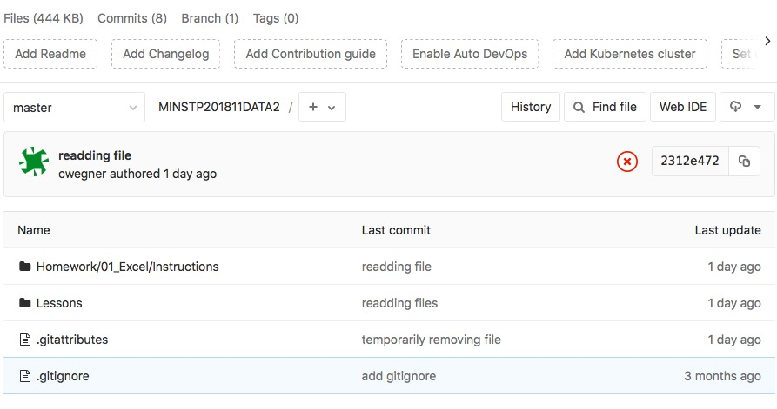
Class Git Repository (UPDATE)

Slide 4
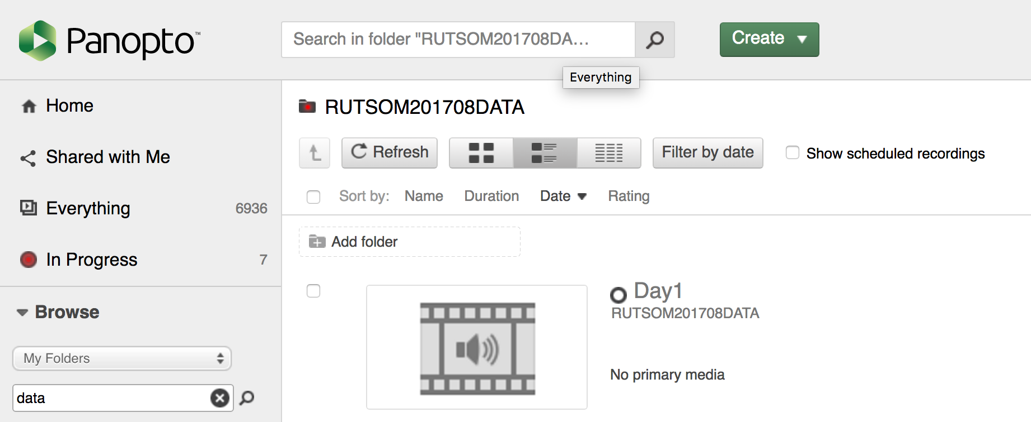
Class Videos (UPDATE)
Class Videos will be automatically uploaded here:
<ENTER PANOPTO LINK HERE>

Slide 5
Homework Assignment #1
You will be analyzing thousands of Kickstarter projects to look for funding trends across goal targets and topics.

Slide 6
Homework Assignment #1
Due: Next Saturday
Recommended Target: Thursday of Next Week

Slide 7
Quick Refresher

Slide 8
Data Science is about what two things?

Slide 9
Truth-Telling & Story Telling

Slide 10
What are the steps in the Analytics Paradigm?

Slide 11
Analytics Paradigm
Decompose the Ask
Identify Data Sources
Define Strategy and Metrics
Build Data Retrieval Plan
Retrieve the Data
Assemble and Clean
Analyze for Trends
Acknowledge Limitations
Make the Call or
Tell the Story
Regardless of type or industry, this paradigm provides a repeatable pathway for effective data problem solving.

Slide 12
Let’s Start with the Basics

Slide 13
Formulas

Slide 14
Ooh… Coding! (Sort Of)
Function
=
SUM(
1, 2, 3
)
Arguments
In a way, Excel has introduced you to a sort of proto-programming. Throughout your time writing scripts you will rely on functions (methods) that do something to or with arguments.

Slide 15
Ooh… Coding! (Sort Of)
Function
=
AVG(
F4:F6
)
Variable Arguments
When we reference a set of range, Excel is being given a set of variable inputs. It will determine the actual values of these inputs prior to executing the function.

Slide 16
Ooh… Coding! (Sort Of)
What about this example?
Which is the function? Which are the arguments?
= SUM( AVG(F4:F6), AVG(G4:G6) )

Slide 17
Ooh… Coding! (Sort Of)
What about this example?
Which is the function? Which are the arguments?
= SUM( AVG(F4:F6), AVG(G4:G6) )
It Depends…

Slide 18
Ooh… Coding! (Sort Of)
What about this example?
Which is the function? Which are the arguments?
= SUM( AVG(F4:F6), AVG(G4:G6) )
The AVG functions takes as their arguments the ranges provided.

Slide 19
Ooh… Coding! (Sort Of)
What about this example?
Which is the function? Which are the arguments?
= SUM( AVG(F4:F6), AVG(G4:G6) )
This is a nested function. We’ll be doing plenty of complex nests in this class.

Slide 20
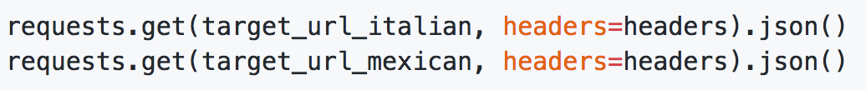
You Can Code Too!
Python Snippet from Last Class

Slide 21
You Can Code Too!
Python Snippet from Last Class
Another Function
(Chained)
Function
Arguments
Syntax and capabilities may differ across technologies and platforms, but fundamental concepts remain the same.

Slide 22
Demo Time! 01-ExcelPlayground, 02-NamedRanges

Slide 23
Conditionals

Slide 24
Conditionals: If This… Then That
Step 2a
If criteria is met…
Step 1
If criteria is not met…
Step 2b
Conditionals present a way to control the flow of logic based on certain criteria being met. This is a core building block in all languages.

Slide 25
Conditionals: If This… Then That
Set Cell to True
If D2 > 5
Determine D2’s Value
If D2 <=5
Set Cell to False
=IF(D2>5,TRUE,FALSE)

Slide 26
But what if… we wanted to combine conditions?

Slide 27
AND, NOT, OR if (a and b) or (c and d)

Slide 28
Conditionals: If This… Then That
=IF(AND(D2>5, D2<10),TRUE,FALSE)

Slide 29
Conditionals: If This… Then That
Set Cell to True
If D2 > 5 AND D2 < 10
Determine D2’s Value
If D2 <=5 OR D2 >= 10
Set Cell to False
Nesting conditionals can quickly become a very convoluted (albeit necessary) part of your data prep.

Slide 30
Demo Time! (03-ColorCounter)

Slide 31
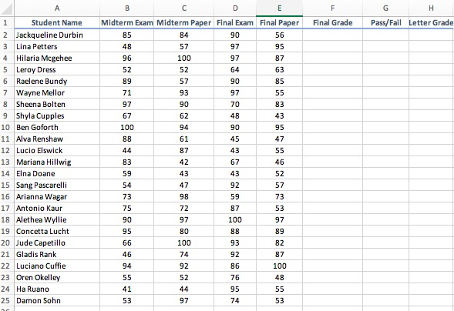
Group Activity: Grade Book

Slide 32
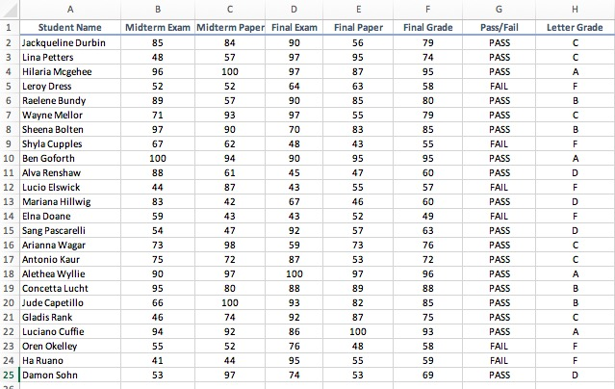
Group Activity: Grade Book

Slide 33
Class Activity! Review Grade Book if (grade >= 90, A, (if grade >= 80, B, if(grade >=70, C, ..D))…)

Slide 34
Demo Time! Multiple Worksheets: Produce Sales

Slide 35
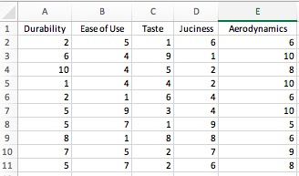
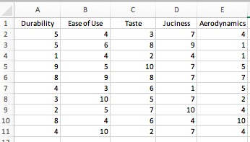
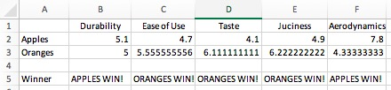
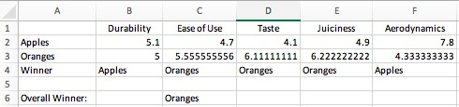
Group Activity: Apples & Oranges

Slide 36
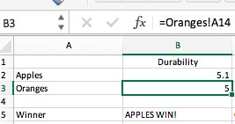
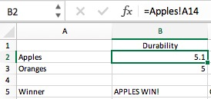
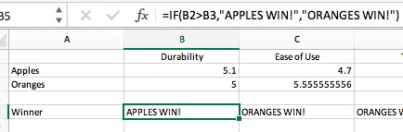
Review Apples and Oranges
Reference the Worksheet
Conditional

Slide 37
Conditional Formatting

Slide 38
Group Activity! McDonald Menu

Slide 39
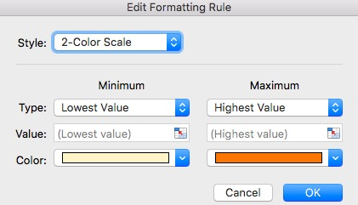
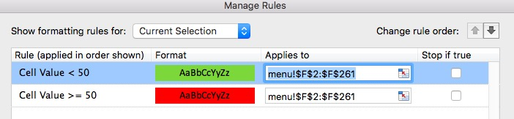
Review McDonald Menu
2-Color Scale
Conditional

Slide 40
BREAK

Slide 41
Pivot Tables

Slide 42
Get Pivot With It
Pivot Tables are another powerful tool in Excel arsenal and one of the most important data visualization concepts to master in this class.
(Don’t worry. They are a cinch to deal with)

Slide 43
Get Pivot With It
Seller | Qty. Sold | Date
Joseph | $42.50 | 1/1/17
Jacob | $65.00 | 1/3/17
Jacob | $5.25 | 1/6/17
Joseph | $125.00 | 1/6/17
Jacob | $3.50 | 1/7/17
Matt | $32.00 | 1/9/17
Seller | Total Sold
Joseph | $167.50
Jacob | $73.75
Matt | $32.0
In essence, Pivot tables are a summative analytic tool that allows us to perform aggregate functions that along any combination of fields.
(The name comes from the fact that we are pivoting along a data axis)

Slide 44
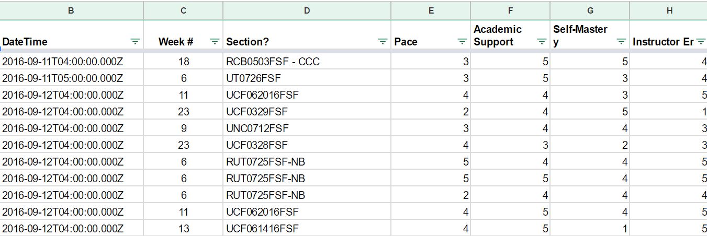
Words to the Wise – Keep It Flat!
Modern BI tools like Tableau, Sisense, and Salesforce work best if data is stored in flat CSVs – meaning column headers represent fields (vertically) on the spreadsheet. This is largely because all of these technologies heavily utilize Pivot Tables beneath their visualizations.
Don’t try to confuse this simplicity. “Spreadsheet magic” is a nightmare to analyze.

Slide 45
Demo Time! (09-PivotTables)

Slide 46
Group Activity! Top Songs

Slide 47
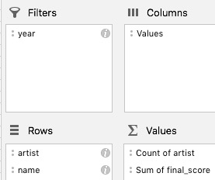
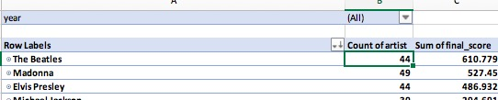
Review Top Songs
Filter Place year in the filter section
Aggregate Artist as the main category Name as the subcategory so all songs are stored under their artist's name
Summation place "artist" into the "Values" section, then count how many times their name appears. the sum of "final_score" is fairly self-explanatory
Sorting based upon an artist's overall score, click on the "Sum of Final_Score" column within the pivot table and select "Sort From Largest to Smallest"

Slide 48
Lookups

Slide 49
Look It Up with Lookups
Planet | Population
Zeelo | 5020
Merinoa | 380
Cardboard Box | 2
… | …
Asteroid 9 | 95
Assume this table is gigantic…
How would we retrieve the population of a specific planet for use in another formula?

Slide 50
Look It Up with Lookups
Planet | Population
Zeelo | 5020
Merinoa | 380
Cardboard Box | 2
… | …
Asteroid 9 | 95
Assume this table is gigantic…
How would we retrieve the population of a specific planet for use in another formula?
=vlookup( <value>, <full table>, <column to retrieve>,<match parameter>)

Slide 51
What Will This Yield?
Planets
Planet | Population | Species
Zeelo | 5020 | Zoltans
Merinoa | 380 | Murphies
Cardboard Box | 2 | Hambones
… | …
Asteroid 9 | 95 | The Asterisks
=vlookup( “Asteroid 9”, Planets, 3, FALSE)

Slide 52
What Will This Yield?
Planets
Planet | Population | Species
Zeelo | 5020 | Zoltans
Merinoa | 380 | Murphies
Cardboard Box | 2 | Hambones
… | …
Asteroid 9 | 95 | The Asterisks
=vlookup( “Astroid 9”, Planets, 3, FALSE)
The Asterisks

Slide 53
Demo Time! (11-Lookups, 12-ProductPivot)

Slide 54
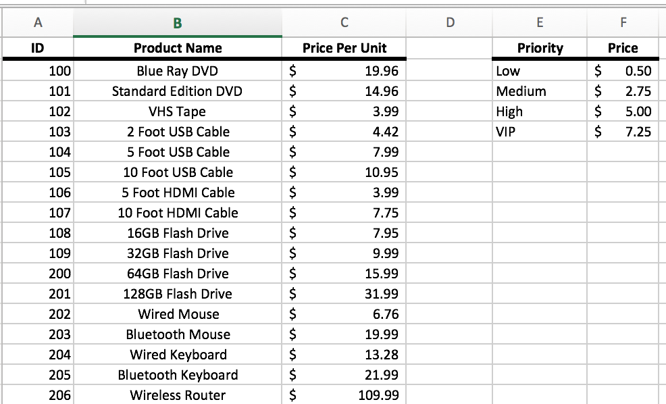
Group Activity!

Slide 55
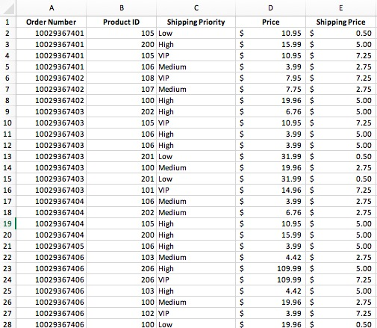
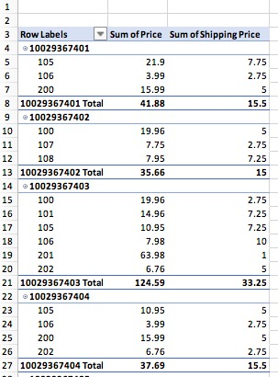
Group Activity … Cont’d

Slide 56
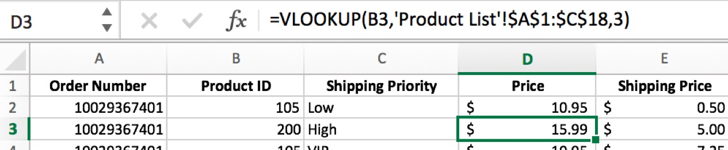
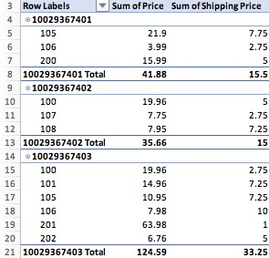
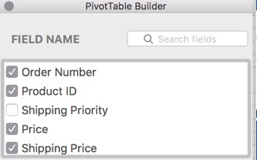
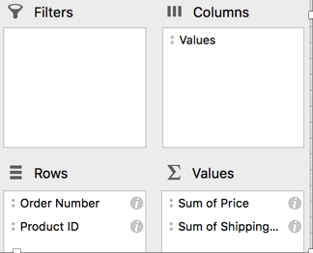
Review Product Lookups

Slide 57
Questions / Discussion
Notes:
It’s important to keep in mind why you joined this class. Let’s talk about your goals.

